Slide 1
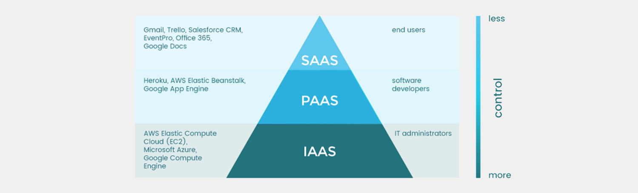
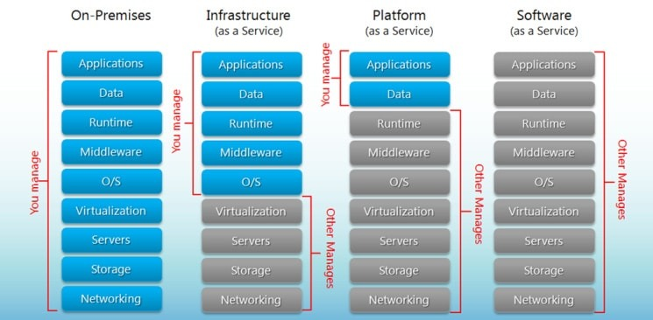
IaaS vs PaaS vs SaaS
Presented By:
Daniel Aasa
Alfred Rwagaju
IaaS
Infrastructure as a Service
PaaS
Platform as a Service
SaaS
Software as a Service

Slide 2
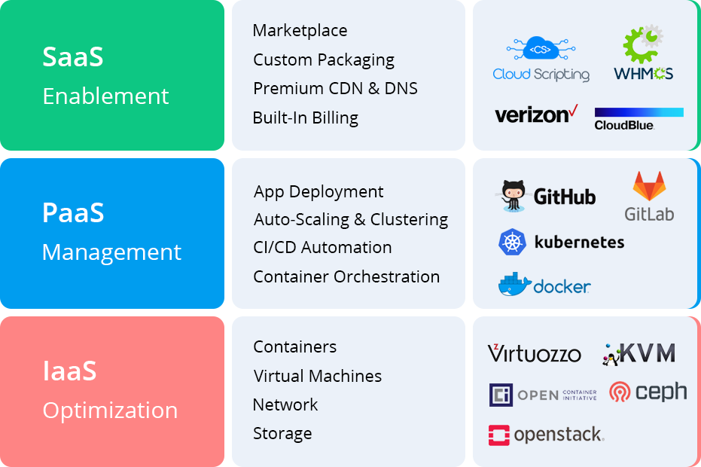
IaaS: Infrastructure as a Service
Use when one wants to directly develop or control both the hardware and software parts of the project
Private Cloud
Great Amount of Control over the whole setup
Good Accessibility
Cheaper than the other Options

Slide 3
PaaS: Platform as a Service
Enough Hardware and software tools are provided to allow for creative development of products.
Public Cloud
Scalable
Easy to run without extensive system

Slide 4
SaaS: Software as a Service
No need to install or run any software, it is available on the open web, good support for common use products.
Public Cloud
Accessible on the internet
Hosted on a remote server
Scalable

Slide 5
Works Cited
“IaaS vs PaaS vs SaaS: What You Need to Know + Examples (2018).” The BigCommerce Blog, 10 Jan. 2020, www.bigcommerce.com/blog/saas-vs-paas-vs-iaas/.
Plesky, Elvis. “IaaS vs PaaS vs SaaS – Cloud Service Models Compared.” Plesk, Plesk, 25 Oct. 2019, www.plesk.com/blog/various/iaas-vs-paas-vs-saas-various-cloud-service-models-compared/.
Dhruv, Stuti. “The Difference between PaaS, IaaS, and SaaS.” Aalpha, 27 Mar. 2020, www.aalpha.net/blog/the-difference-between-paas-iaas-and-saas/.

